Slide 1
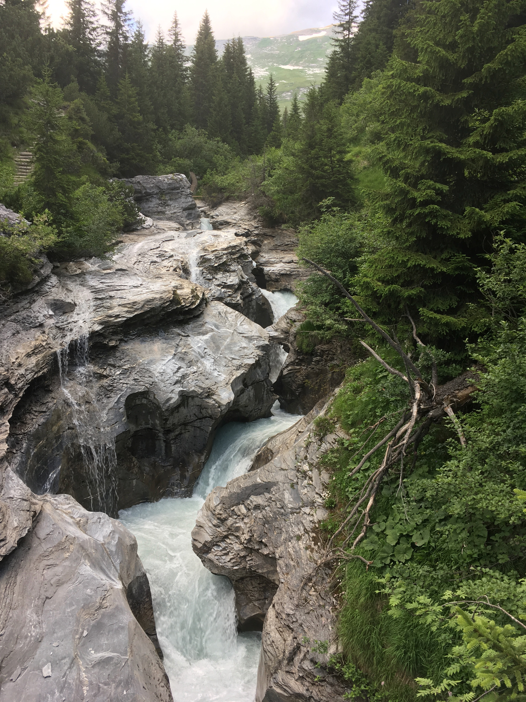




IMPACTS OF
CLIMATE CHANGE
ON THE
DISCHARGE OF
CATCHMENTS
Supplementary material
Encyclopedia of Water:
Science, Technology, and Society
Chapter:
Hydrological climate change impact modeling
Introduction to project

Slide 2
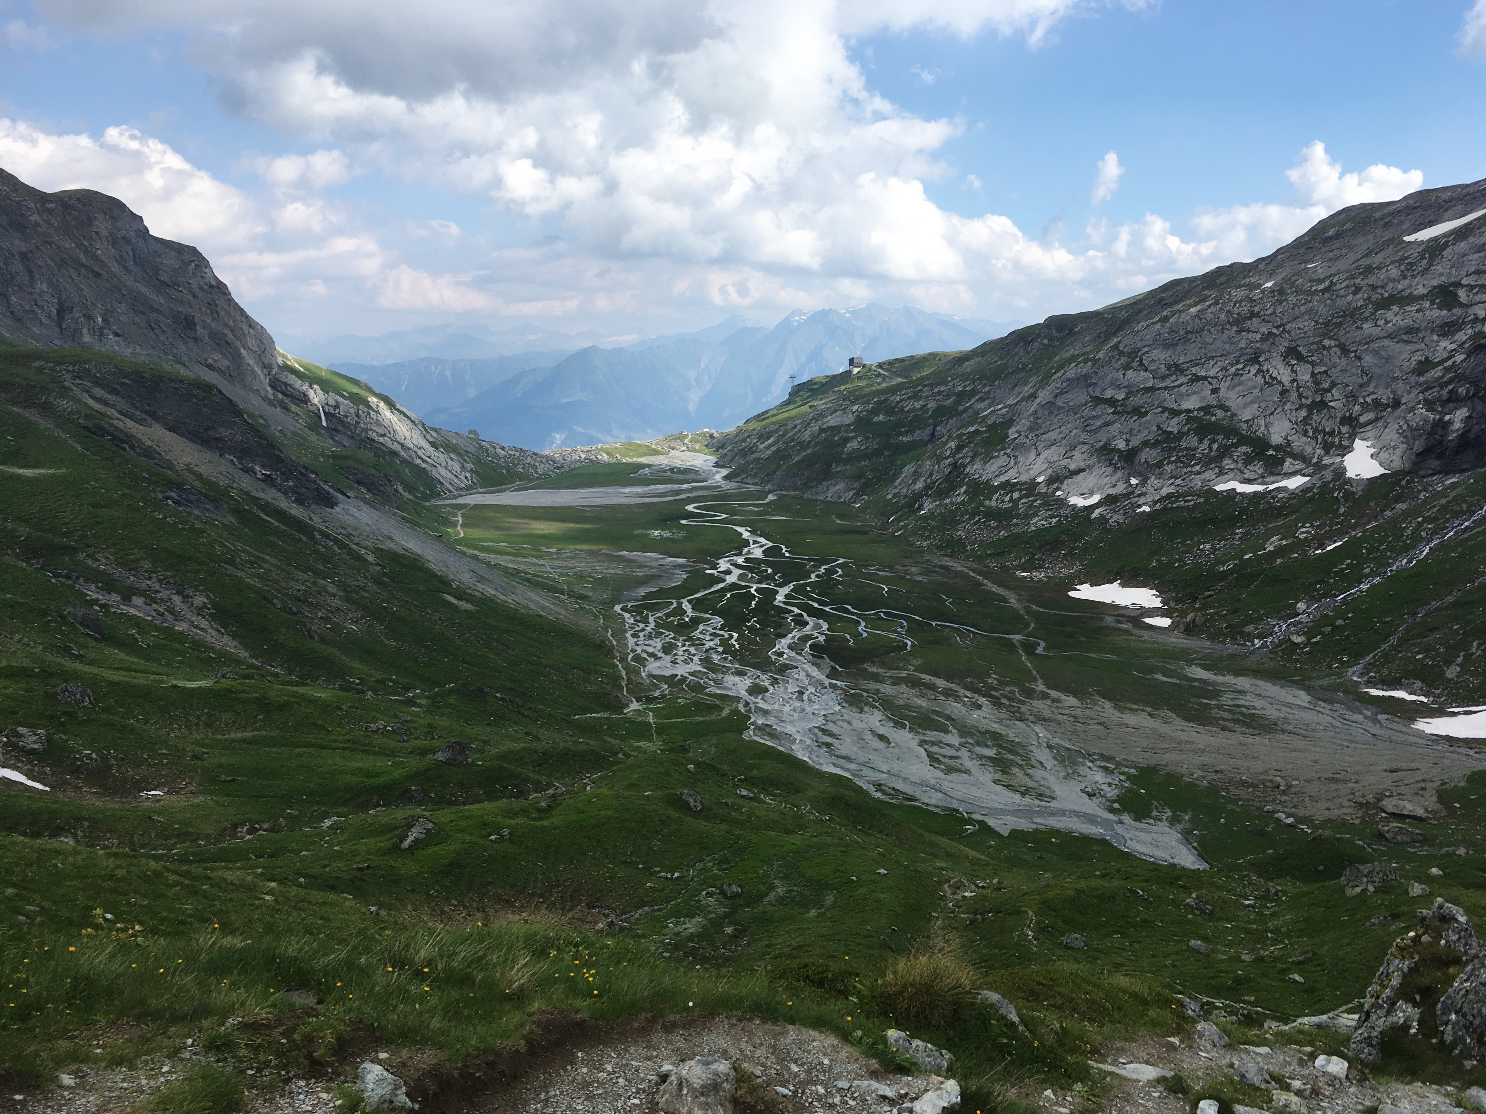
About this project:
You will use HBV Light
You will perform your analysis on the catchment provided
We expect that you spend ~10 hours on this project
HBV Light: (Seibert, J., and M. J. P. Vis, 2012: Teaching hydrological modeling with a user-friendly catchment-runoff-model software package. Hydrol. Earth Syst. Sci.,16, 3315–3325, doi:10.5194/hess-16-3315-2012.)

Slide 3
Tasks:
Introduce catchment
  Describe hydrological regime (e.g. geology, kast influences, etc.) in relation to the observed discharge data (Qobs), as well as for observed precipitation and temperature.
Choose one calibration method to attain simulated discharge (Qsim_hist)
  Manual calibration
  Monte-Carlo calibration = automatic calibration
  Genetic algorithm (GAP) = automatic calibration
Simulation under present climate
  Compare observed (Qobs) vs. simulated discharge (Qsim_hist)
Choose scenario & simulate discharge under climate change
  Compare simulations under climate change (Qsim_fut) vs. historical (Qsim_hist)
Go beyond the annual cycle! (personalize your presentation)

Slide 4
Comparisons in light of uncertainties:
Uncertainty due to limitations of the hydrological model and the calibration
Isolates the effects of the future climate scenario on discharge
Simulated historical discharge (Qsim_hist)
Discharge [mm/day]
Observational discharge (Qobs)
Simulated future discharge (Qsim_fut)
J F M A M J J A S O N D

Slide 5
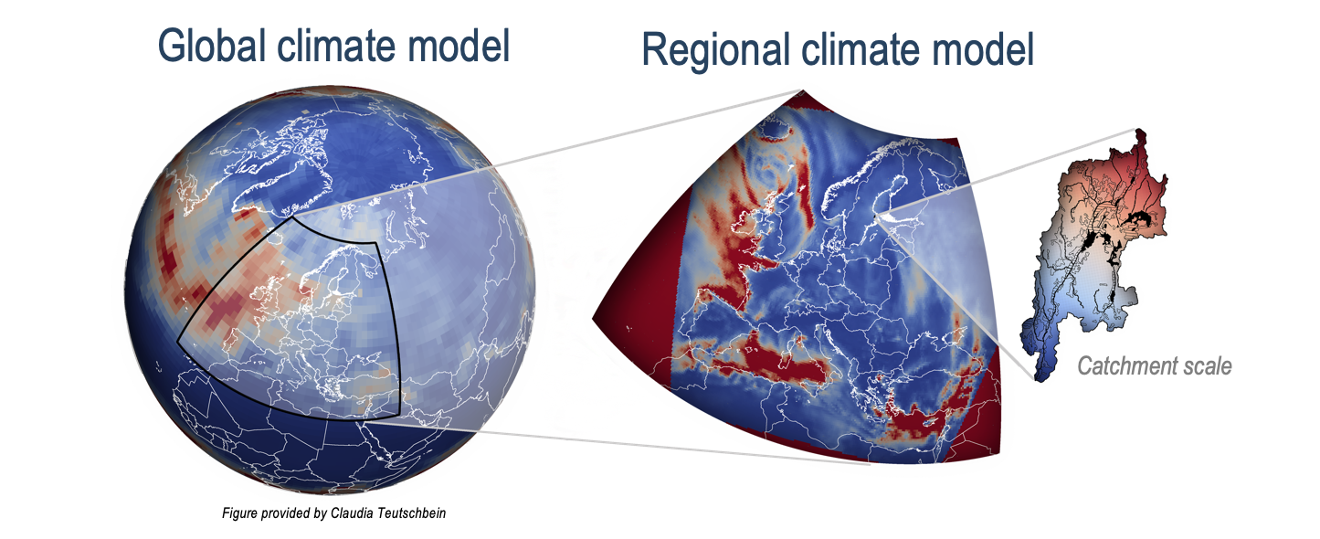
Delta Change Method:
Historical
Future
Temp output from climate model
(Scenario 1)
For example, consider the future period 2085-2100:
+3 °C temperature increase for the spring season (MAM)
1980
2009
2035
2060
2085
2100
Delta change method
(Scenario 1)
A factor of +3 °C is then added to the observed temperature time series for the season of MAM.
This is repeated for each season per time period.
After these factors have been applied for all seasons and time periods, this results in the future time series.
1980
2009
2035
2060
2085
2100

Slide 6
Delta Change Method:
Tfuture = Tobserved + Δ _{T}
Region 1
Region 2
Region 3
Scenario 1
4
4
4
2
2
2
Temperature change [°C]
0
0
0
J F M A M J J A S O N D
J F M A M J J A S O N D
J F M A M J J A S O N D
Climate Scenario | Scenario 1 | Scenario 2 | Scenario 3
Description | Non-intervention scenario with high fossil fuel emissions | Some carbon mitigation | Strong carbon mitigation
Scenario 2
4
4
4
Temperature change [°C]
2
2
2
0
0
0
J F M A M J J A S O N D
J F M A M J J A S O N D
J F M A M J J A S O N D
Scenario 3
4
4
4
Temperature change [°C]
2
2
2
0
0
0
See Fisher et al., 2012 (Figures 9 & 10):
J F M A M J J A S O N D
J F M A M J J A S O N D
J F M A M J J A S O N D
Fischer, A.M., Weigel, A.P., Buser, C.M., Knutti, R., Künsch, H.R., Liniger, M.A., Schär, C. and Appenzeller, C., 2012: Climate change projections for Switzerland based on a Bayesian multi-model approachInt. J. Climatol. 32, 2348–2371.
Notes:
Tell students to find Δ _{T} values for their catchment or region or the values can be provided by the instructor. See Fischer et al., 2012 figures 9 and 10 for an example of delta values for different regions in Switzerland.

Slide 7
Delta Change Method:
Pfuture = Pobserved * Δ _{P}
Region 1
Region 2
Region 3
Scenario 1
10
10
10
Precipitation change [%]
-10
-10
-10
-30
-30
-30
J F M A M J J A S O N D
J F M A M J J A S O N D
J F M A M J J A S O N D
Climate Scenario | Scenario 1 | Scenario 2 | Scenario 3
Description | Non-intervention scenario with high fossil fuel emissions | Some carbon mitigation | Strong carbon mitigation
Scenario 2
10
10
10
Precipitation change [%]
-10
-10
-10
-30
-30
-30
J F M A M J J A S O N D
J F M A M J J A S O N D
J F M A M J J A S O N D
Scenario 3
10
10
10
Precipitation change [%]
-10
-10
-10
-30
-30
-30
See Fisher et al., 2012 (Figures 9 & 10):
J F M A M J J A S O N D
J F M A M J J A S O N D
J F M A M J J A S O N D
Fischer, A.M., Weigel, A.P., Buser, C.M., Knutti, R., Künsch, H.R., Liniger, M.A., Schär, C. and Appenzeller, C., 2012: Climate change projections for Switzerland based on a Bayesian multi-model approachInt. J. Climatol. 32, 2348–2371.
Notes:
Tell student to find Δ _{P} values for their catchment or region or the values can be provided by the instructor. See Fischer et al., 2012 figures 9 and 10 for an example of delta values for different regions in Switzerland.

Slide 8
What should the presentation include:
Introduction of your catchment (1-2 slides)
Annual cycle of historical time series (1 slide)
-Explain the behavior of observational discharge in relation to the historical temperature and precipitation provided
Explain the type of calibration method you chose (1 slide)
-Provide scores of calibration and validation & your interpretation
Show plot of Qobs vs Qsim_hist (1 slide)
-What are the limitations of the calibration and validation
Introduce the climate change scenario that you chose (1 slide)
-What are the assumptions of this scenario & the associated uncertainties
Show plot of future seasonal cycles (1 slide)
-Explain the behavior of the projected discharge in relation to the changes in precipitation and temperature
(i.e. relate the changes in discharge to changes in real hydrological processes.
Go beyond the annual cycle! (length is up to you- be creative!)
-Your group should email the instructor by ________, stating your personalized idea.
(e.g. seasonal variation, maximum yearly discharge, # of days with a discharge lower (higher) than the 10% or 90% quantile)

Slide 9
Evaluation criteria:
Topics | Elements | Comment | Maximum score | Score
Project | Catchment description |  | 3
 | Catchment calibration, validation and simulation under present climate |  | 6
 | Discharge projections |  | 6
 | Beyond the seasonal cycle |  | 4
 | Discussion |  | 8
 | Personal contributions |  | 1
 | Graphics style, axis, readability |  | 2
Total |  |  | 30

Slide 10
Files provided by instructor:
PTQ.txt: The PTQ-file contains time series of precipitation [mm/day], temperature [°C] and discharge [mm/day].
T_mean.txt: The T_mean-file contains the long-term values for temperature [°C].
EVAP.txt: The EVAP-file contains values for the potential evaporation [mm/day].
Parameter.xml: The parameter-file specifies parameter values to be applied to the catchment.
Clarea.xml: The clarea-file contains catchment setting information including number of elevation zones, vegetations zones as well as height increment variables.
ΔT and ΔP: Delta factors for temperature and precipitation should either be provided by your instructor or literature should be provided where these values can be found.
Climatechange_project.R: R-file contains script that analyzes output from HBV and plots it. You will need to update this script with your own file paths and to expand upon the basic analysis within the file.
Notes:
These files should be provided by the instructor. The delta T and P values can either be provided by literature or the instructor can provide.

Slide 11
Questions?

